Slide 1
TCP CONGESTION CONTROL SUITED FOR BANDWIDTH RESERVATION NETWORK
BY
K.M Fahim Shahriyar
Student id: 1805113

Slide 2
Reference
https://www.researchgate.net/publication/241147809_A_Proposal_of_TCP_Congestion_Control_Scheme_Suited_for_Bandwidth_Reservation_Network

Slide 3
INTRO
Congestion control Protocol has some phases ➔
i)Slow start phase
ii)Congestion Avoidence Phase
iii)Fast Retransmit Phase
iv)Fast Recovery Phase

Slide 4
INTRO
There are some well known Congestion Control Protocols ➔
i)TCP old Tahoe
ii)TCP New Tahoe
iii)TCP old Reno
iv)TCP New Reno etc
* NS2 has some Congestion Control Protocols built in among which TCP New Reno will be modified

Slide 5
MOTIVATION and GOAL
In Bandwidth Reservation Network the bandwidth for a certain application is reserved for faster transmission
So that’s why the goal of my modification is ➔
In Fast Recovery algorithm ,
the variation of Congestion window size will be minimized

Slide 6
ExiSTING REASONING
In existing TCP New Reno implementation, In Fast Recovery Algorithm,
whenever a packet loss detected by RTO time out
➔ Congestion window size(cwnd) resets to 1
➔ Slow start threshold(ssthresh) = current window size(cwnd)/2
whenever a packet loss detected by Duplicate Acknowledgment
➔ Slow start threshold(ssthresh) = cwnd /2
➔ cwnd = ssthresh

Slide 7
ExiSTING REASONING
In existing TCP New Reno implementation, In Fast Recovery Algorithm,
whenever a packet loss detected by RTO time out
➔ Congestion window size(cwnd) resets to 1
➔ Slow start threshold(ssthresh) = current window size(cwnd)/2
whenever a packet loss detected by Duplicate Acknowledgment
➔ Slow start threshold(ssthresh) = cwnd /2
➔ cwnd = ssthresh

Slide 8
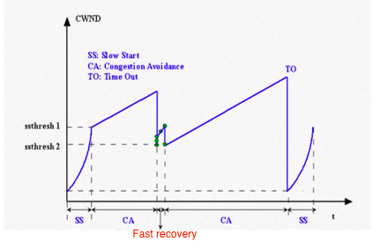
ExISTING REASONING

Slide 9
MODIFIED REASONING
In existing TCP New Reno implementation, In Fast Recovery Algorithm,
1)whenever a packet loss detected by RTO time out
➔ Slow start threshold(ssthresh) = (r / size*8)* RTT
➔ Congestion window size(cwnd) resets to 1
2) whenever a packet loss detected by Duplicate Acknowledgment
➔ Slow start threshold(ssthresh) = (r / size*8)* RTT
➔ cwnd = ssthresh
r = Reserved B/W
size = Packet Size (in bytes)
RTT = Estimated RTT

Slide 10
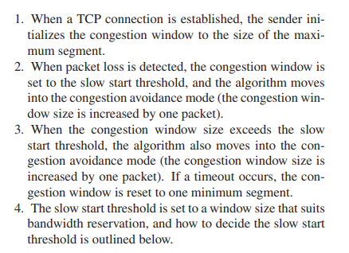
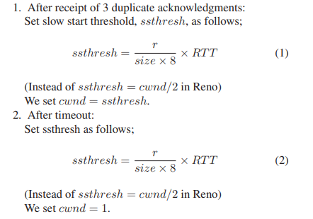
MODIFIED REASONING

Slide 11
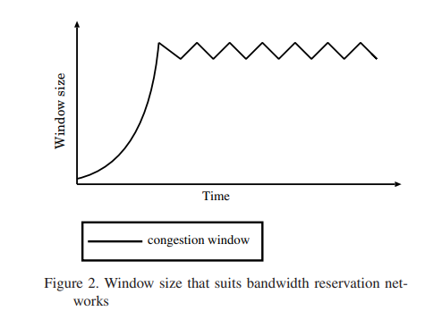
MODIFIED REASONING

Slide 12
ExPECTED IMPROVEMENT
The Congestion Window Size in BR TCP will be more stable rather than TCP Reno
2) The Average and Maximum throughput is expected to be
higher in BR TCP

